Slide 1
Awareness Training on IMS
Facilitated by
Md. Kaiser Hamid

Slide 2
Introduction

Slide 3

Introduction of
MD.KAISER HAMID
kaiser.hr00@yahoo.com , +88 01672 42 06 00
Consultant/Lead Auditor/Trainer on:
ISO 9001:2008 (Quality Management System) Lead Auditor
ISO 14001:2004 (Environmental Management System) Consultant
OHSAS 18001: 2007 Occupational Health & Safety(OHS) Consultant
Human Resource Management (HRM) Consultant
Social Compliance – Consultant
Education- BBA,MBA,PGD
Previous Employer :
Asst. Manager- Bay City GmbH- (Germanys Brand)
Coordinator-TAKKO Holding GmbH – (Germanys Brand)
Asst. Manager- Maruhisa Pacific co Ltd (Japanese)

Slide 4
TRAINING ON
IMS - INTEGRATED MANAGEMENT SYSTEMS-
(ISO9001:2008,ISO 14001: 2004
& OHSAS 18001:2007)

Slide 5
What is IMS
The Integrated Management System (IMS) integrates the management systems for quality, environment and safety, for example, including all synergy effects, to create a new overall management system, in which the processes, interfaces, structures and documentation systems of the individual systems are combined into a standard system.
Quality
and process mgmt
Environment
Safety
Balanced
scorecard
systems
Vision
Goals
P r o c e s s e s
Management
report
Work safety
Hazardous materials
Emergency/ fire safety
Corporate
planning
Corporate evaluation
Corporate
ranking
Corporate management

Slide 6
Benefits of this IMS Approach
Provides a framework for a holistic management system that can embrace all the processes and elements that need to be controlled by the organization.
Best Quality
Lower Cost
On Time Delivery
Pollution Prevention
Legal Compliance
Managing Natural Resources
Human Resources Development
Continual Improvement

Slide 7
ISO 9001:2008
Main Elements
4 Quality Management System
5 Management Responsibility
6 Resource Management
7 Product Realization
8 Measurement, Analysis and Improvement

Slide 8
Quality Management Process Model
Continual improvement of the quality management system
Management
responsibility
Customer
Customer
Resource
Management
Measurement,
analysis and
improvement
Satisfaction
Requirements
input
output
Product
realization
Product

Slide 9
QUALITY MANAGEMENT SYSTEM PRINCIPLES
Customer Focus
Leadership
Involvement of the people.
Process Approach
System Approach to Management
Continual Improvement
Factual Approach to Decision Making
Mutually Beneficial Supplier Relationships
Notes:
Customer focus mean their requirements are consistently meet and effort are given to exceed their requirements. Leadership establish unity of purpose and direction of organization to meet business objectives also ensure everybody involvement for the same purpose. For an organization to function effectively, management has to identify and co-ordinate numerous linked activities. An activity that takes “input” and converts them to output can be considered as process. Very often the output from one process is input to another process. The effectiveness and efficiency of an organization is improved by identifying, understanding and managing a system of interrelated processes, needed to achieve the objectives. example is triple role of ISO. This is exactly what ISO is required.
This General Requirements sets the stage for the standard. It paints with a broad brush what is expected of the system
Note the update when necessary clauses
Note the outsourced processes with food safety implications need to be managed within the FSMS

Slide 10
Requirements of - ISO 14001
Figure 1 from ISO 14001
Continual Improvement
Environmental
Policy
Management
Review
Planning
Checking &
Corrective Action
Implementation
& Operation

Slide 11
Environmental Aspects
Aspects are “cause”, impact is the “effect”
Control and influence of aspects is a factor
Aspects can be:
direct or indirect
normal, abnormal, or emergency
past, present, or future

Slide 12
OHSAS 18001
Continual Improvement
(Initial Status Review)
Management Review
OH&S Policy
Checking & Corrective Action
Planning
Implementation & Operation

Slide 13
Risk Assessment
Definition of Hazard: -
A source or a situation with potential for harm in terms of human injury or ill-health, damage to property, damage to the environment, or a combination of these.
Definition of Risk: -
The combination of the likelihood and consequences of a specified hazardous event occurring.
Notes:
Delegate Notes
Risk Assessment Benefits Identifies activities/areas where there are significant risks to health and occupational health and safety Is pro-active - does not wait for legislative or reactive measures Can be used as a positive tool to involve workforce in effective controls - cultural benefits

Slide 14
Comparison of ISO-QMS,EMS & OHS
OHSAS 18001:2007 |  | ISO 14001:2004 |  | ISO 9001:2008
— | Introduction | — | Introduction | 0 0.1 0.2 0.3 0.4 | Introduction General Process approach Relationship with ISO 9004 Compatibility with other management systems
1 | Scope | 1 | Scope | 1 1.1 1.2 | Scope General Application
2 | Normative references | 2 | Normative references | 2 | Normative reference
3 | Terms and definitions | 3 | Terms and definitions | 3 | Terms and definitions
4 | OH&S management system elements (title only) | 4 | Environmental management system requirements (title only) | 4 | Quality management system (title only)
4.1 | General requirements | 4.1 | General requirements | 4.1 5.5 5.5.1 | General requirements Responsibility, authority and communication Responsibility and authority

Slide 15
OHSAS 18001:2007 |  | ISO 14001:2004 |  | ISO 9001:2000
4.2 | OH&S policy | 4.2 | Environmental policy | 5.1 5.3 8.5.1 | Management commitment Quality policy Continual improvement
4.3 | Planning (title only) | 4.3 | Planning (title only) | 5.4 | Planning (title only)
4.3.1 | Hazard identification, risk assessment and determining controls | 4.3.1 | Environmental aspects | 5.2 7.2.1 7.2.2 | Customer focus Determination of requirements related to the product Review of requirements related to the product
4.3.2 | Legal and other requirements | 4.3.2 | Legal and other requirements | 5.2 7.2.1 | Customer focus Determination of requirements related to the product
4.3.3 | Objectives and programme(s) | 4.3.3 | Objectives, targets and programme(s) | 5.4.1 5.4.2 8.5.1 | Quality objectives Quality management system planning Continual improvement
4.4 | Implementation and operation (title only) | 4.4 | Implementation and operation (title only) | 7 | Product realization (title only)
4.4.1 | Resources, roles, responsibility, accountability and authority | 4.4.1 | Resources, roles, responsibility and authority | 5.1 5.5.1 5.5.2 6.1 6.3 | Management commitment Responsibility and authority Management representative Provision of resources Infrastructure

Slide 16
OHSAS 18001:2007 |  | ISO 14001:2004 |  | ISO 9001:2000
4.4.2 | Competence, training and awareness | 4.4.2 | Competence, training and awareness | 6.2.1 6.2.2 | (Human resources) General Competence, awareness and training
4.4.3 | Communication, participation and consultation | 4.4.3 | Communication | 5.5.3 7.2.3 | Internal communication Customer communication
4.4.4 | Documentation | 4.4.4 | Documentation | 4.2.1 | (Documentation requirements) General
4.4.5 | Control of documents | 4.4.5 | Control of documents | 4.2.3 | Control of documents
4.4.6 | Operational control | 4.4.6 | Operational control | 7.1 7.2 7.2.1 7.2.2 7.3.1 7.3.2 7.3.3 7.3.4 7.3.5 7.3.6 7.3.7 7.4.1 7.4.2 7.4.3 7.5 7.5.1 7.5.2 7.5.5 | Planning of product realization Customer-related processes Determination of requirements related to the product Review of requirements related to the product Design and development planning Design and development inputs Design and development outputs Design and development review Design and development verification Design and development validation Control of design and development changes Purchasing process Purchasing information Verification of purchased product Production and service provision Control of production and service provision Validation of processes for production and service provision Preservation of product
4.4.7 | Emergency preparedness and response | 4.4.7 | Emergency preparedness and response | 8.3 | Control of nonconforming product

Slide 17
OHSAS 18001:2007 |  | ISO 14001:2004 |  | ISO 9001:2000
4.5 | Checking (title only) | 4.5 | Checking (title only) | 8 | Measurement, analysis and improvement (title only)
4.5.1 | Performance measurement and monitoring | 4.5.1 | Monitoring and measurement | 7.6 8.1 8.2.3 8.2.4 8.4 | Control of monitoring and measuring devices (Measurement, analysis and improvement) General Monitoring and measurement of processes Monitoring and measurement of product Analysis of data
4.5.2 | Evaluation of compliance | 4.5.2 | Evaluation of compliance | 8.2.3 8.2.4 | Monitoring and measurement of processes Monitoring and measurement of product
4.5.3 | Incident investigation, nonconformity, corrective action and preventive action (title only) | — | — | — | —
4.5.3.1 | Incident investigation | — | — | — | —
4.5.3.2 | Nonconformity, corrective and preventive action | 4.5.3 | Nonconformity, corrective action and preventive action | 8.3 8.4 8.5.2 8.5.3 | Control of nonconforming product Analysis of data Corrective action Preventive action
4.5.4 | Control of records | 4.5.4 | Control of records | 4.2.4 | Control of records
4.5.5 | Internal audit | 4.5.5 | Internal audit | 8.2.2 | Internal audit
4.6 | Management review | 4.6 | Management review | 5.1 5.6 5.6.1 5.6.2 5.6.3 8.5.1 | Management commitment Management review (title only) General Review input Review output Continual improvement

Slide 18
Similar clause of QMS,EMS & OHS
QMS/EMS/OHS Policy-
Legal and Other Requirements-
Objectives Targets & Program
Resources, roles, responsibility and authority
Competence, training and awareness-
Communication
Documentation
Document Control
Operational Control
Monitoring and measurement-
Nonconformity and preventative and corrective action
Records
Internal audit-
Management review

Slide 19
Customer Satisfaction
FEEDBACK
Comment Card
Customer Questionnaire
Focus Group
Telephone
Customer Visit
Online feedback
Suggestion Box

Slide 20
Benefits of Feed Back
Customer Dissatisfaction
Analysis existing quality
Root cause identify
Performance Appraisal
Customer Needs-Requirements in Design
Improvements in Every Stage

Slide 21
EMS-14001 Not similar with QMS
Environmental Aspects- 4.3.1
Legal and Other Requirements- 4.3.2
Emergency preparedness and response- 4.4.7
Evaluation of legal compliance- 4.5.2

Slide 22
OHSAS-18001 Not similar with QMS
Hazard identification, risk assessment and
determining controls- 4.3.1
Legal and Other Requirements- 4.3.2
Emergency preparedness and response- 4.4.7
Evaluation of legal compliance- 4.5.2

Slide 23
Role of Senior Management
Establish Policies
Develop a Leadership System
Clearly Define Roles & Responsibilities- Fire, Env, OHS.
Train The Employees
Award and Recognition
Emphasis More on Quality Than Quantity
Effective Communication
Fix Responsibility on Everyone
Care For Customers

Slide 24
COMMUNICATION
Two Way Process
Feedback
Simple in Language
Specific to the topic
Written Format
Legally Binding
Decision Making

Slide 25
Impact of Pollution

Slide 26
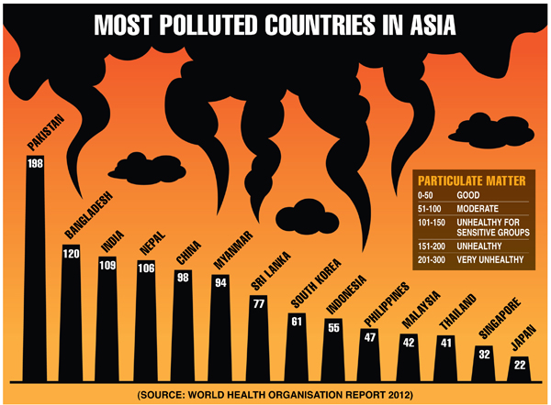

Slide 27
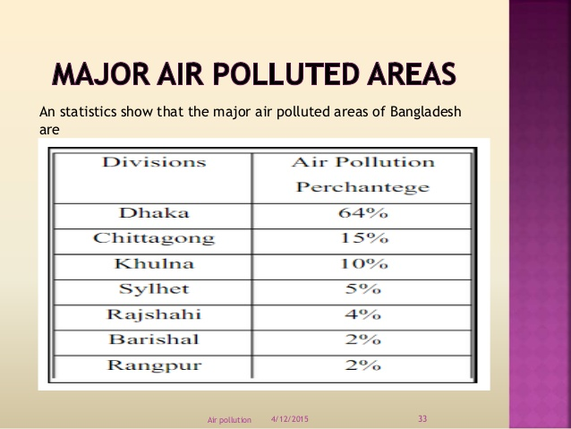

Slide 28
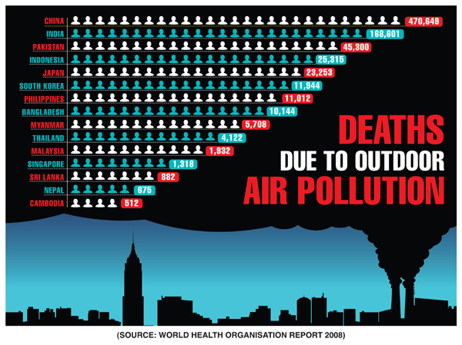

Slide 29
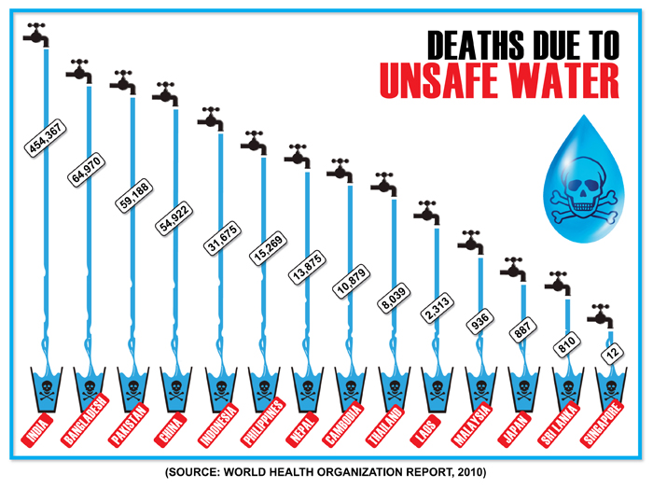

Slide 30
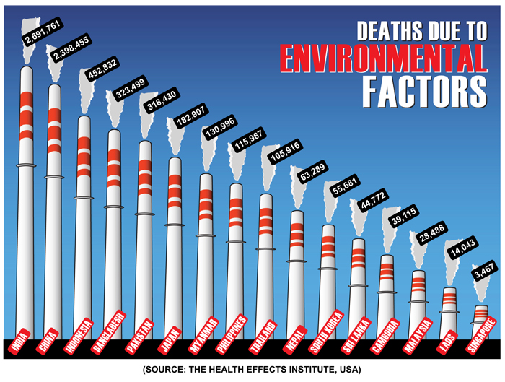

Slide 31
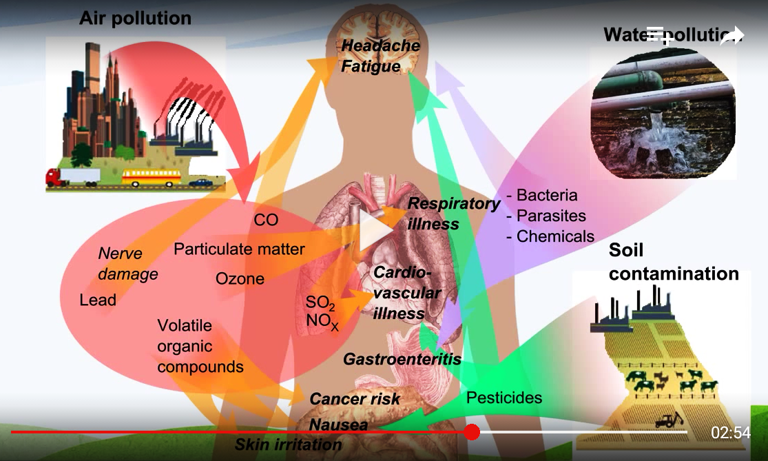

Slide 32
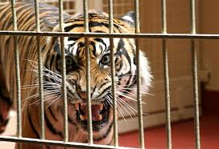
What Are Hazard?
Anything with the Potential to Cause Harm
Ask the question: Does it have the potential to cause harm?
If the answer is yes,
Then it is a hazard.
Usually hidden and in latent form
People: Poor health, injury or fatality
Environment: Negative Impact
Asset: Property Damage
Reputation: Loss

Slide 33

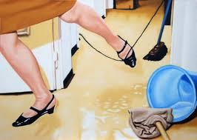
What are Hazards?

Slide 34
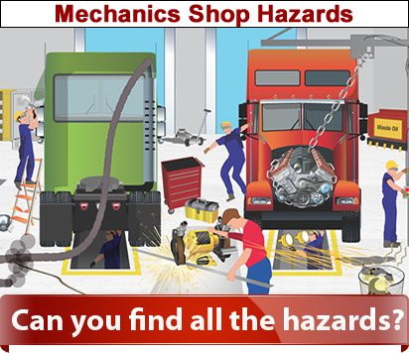
Identify the Hazards?

Slide 35
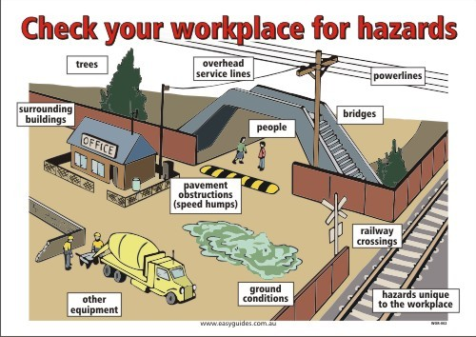
Identify the Hazards?

Slide 36
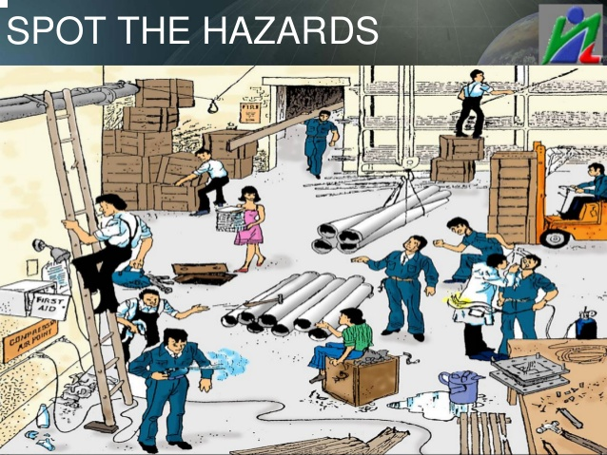
Identify the Hazards?

Slide 37
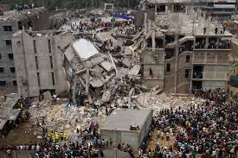
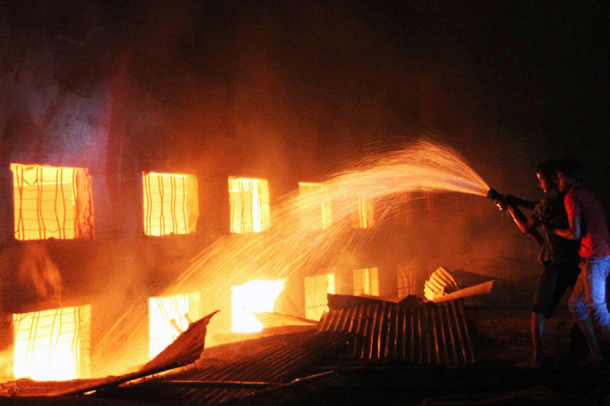
Major Incidents
Rana Plaza
Tazree

Slide 38
Result of Hazard
Factory Name | Number of Fatality | Year
Sareka Garments | 32 | 1990
Lusaka Garments | 02 | 1996
Tamanna Garments | 22 | 1997
Chowdhury Knitwear | 53 | 2000
Maico Sweater | 24 | 2001
Global Kniting | 12 | 2002
Misco Super Market Building | 09 | 2004
Shan Kniting | 23 | 2005
Spectrum Factory | 65 | 2005
KTS, Chittagong | 67 | 2006
Jamuna Shipping Mill | 06 | 2006
Phoenix Garments | 22 | 2006
Garib & garib | 21 | 2010
That’s it Sweater (Hameem Group) | 29 | 2010
Eurotex | 02 | 2011
Tazrieen Fahion | 114 | 2014
RANA PLAZA | 1126 In One Accident | 2013

Slide 39


Slide 40

What about our Present situation

Slide 41
My Observation And Planning
3R
Realistic objective and target (Central to ind Dept)
Value added society and organization
Cost reduce
IMS practice

Slide 42
Some others Compliance standard

Slide 43
8. Social Compliance
List of Social Compliance & International Standard
SA8000
BSCI
SEDEX
WRAP
C-TPAT
ACCORD
ALLIANCE
BUYER COC

Slide 44
8. Social Compliance
About- SA 8000
The SA8000 Standard is the central document of our work at SAI. It is one of the world’s first auditable social certification standards for decent workplaces, across all industrial sectors. It is based on the UN Declaration of Human Rights, conventions of the ILO, UN and national law, and spans industry and corporate codes to create a common language to measure social performance. It takes a management systems approach by setting out the structures and procedures that companies must adopt in order to ensure that compliance with the standard is continuously reviewed. Those seeking to comply with SA8000 have adopted policies and procedures that protect the basic human rights of workers.

Slide 45
8. Social Compliance
About BSCI-Business Social Compliance Initiative
BSCI was launched in 2003 as an initiative of the Foreign Trade Association (FTA) in response to the increasing business demand for transparent and improved working conditions in the global supply chain. An overview of the background to BSCI can be found under Why BSCI exists.
We unite over 1,500 companies around one common Code of Conduct and support them in their efforts towards building an ethical supply chain by providing them with a step-by-step development-oriented system, applicable to all sectors and all sourcing countries.
The fundamental goals of BSCI are only achievable through a strong commitment from participants to implement the system. Our work is based on the BSCI Code of Conduct, which our participants accept upon joining us. The code ensures a strong and credible commitment from both BSCI participants and their business partners to achieve our goals.

Slide 46
8. Social Compliance
About SEDEX-Supplier Ethical Data Exchange
Sedex is a not for profit membership organisation dedicated to driving improvements in ethical and responsible business practices in global supply chains.
As the largest collaborative platform for sharing ethical supply chain data, Sedex is an innovative and effective supply chain management solution, helping you to reduce risk, protect your company reputation and improve supply chain practices

Slide 47
8. Social Compliance
About Worldwide Responsible Accredited Production (WRAP)
Worldwide Responsible Accredited Production (WRAP) is an independent, objective, non-profit team of global social compliance experts dedicated to promoting safe, lawful, humane and ethical manufacturing around the world through certification and education. WRAP is headquartered in Arlington, Virginia, USA and has branch offices in Hong Kong and Bangladesh and additional representatives in India and SE Asia (Thailand & Vietnam).
WRAP's 12 Principles
1. Compliance with Laws and Workplace Regulations
2. Prohibition of Forced Labor
3. Prohibition of Child Labor
4. Prohibition of Harassment or Abuse
5. Compensation and Benefits
6. Hours of Work
7. Prohibition of Discrimination
8. Health and Safety
9. Freedom of Association and Collective Bargaining
10. Environment
11. Customs Compliance
12. Security

Slide 48
8. Social Compliance
About Customs-Trade Partnership Against Terrorism (C-TPAT)
The Customs-Trade Partnership Against Terrorism (C-TPAT) is a voluntary supply chain security program led by U.S. Customs and Border Protection (CBP) and focused on improving the security of private companies' supply chains with respect to terrorism. The program was launched in November 2001 with seven initial participants, all large U.S. companies. As of December 1, 2014, the program has 10,854 members.[1] The 4,315 importers in the program account for approximately 54% of the value of all merchandise imported into the U.S.
Companies who achieve C-TPAT certification must have a documented process for determining and alleviating risk throughout their international supply chain. This allows companies to be considered low risk, resulting in expedited processing of their cargo, including fewer Customs examinations.

Slide 49
8. Social Compliance
Most Common COC
Legal requirements
child labour
Health and safety
Workers’ rights
Non-discrimination
Environment
Compensation
Legally binding employment relationship

Slide 50


Slide 51
Thank You
•
•
•
Identify applicable
Identify applicable
Identify applicable
Legal and
other
Legal and
other
Legal and
other
ISO 9001
ISO 9001
ISO 9001
-
Quality (QMS)
-
Quality (QMS)
-
Quality (QMS)
•
•
•
Demonstr
Demonstr
Demonstr
ate the abil
ate the abil
ate the abil
ity of processes to achie
ve planned
ity of processes to achie
ve planned
ity of processes to achie
ve planned
•
•
•
Briefing on I
Briefing on I
Briefing on I
SO 9001, ISO
SO 9001, ISO
SO 9001, ISO
•
•
•
•
•
•
Certification
Certification
Certification
Structure and
Structure and
Structure and
Resp
onsibilities
Resp
onsibilities
Resp
onsibilities
●
●
●
•
•
•
•
•
•
Risk Inventory, Risk
Risk Inventory, Risk
Risk Inventory, Risk
Appointment of managemen
Appointment of managemen
Appointment of managemen
t
t
t
•
•
•
OHS Policy
OHS Policy
OHS Policy
●
●
●
IMS Documents
IMS Documents
IMS Documents
Structure
Structure
Structure
Process approach
Process approach
Process approach
FORMS
FORMS
FORMS
Quality Management P
Quality Management P
Quality Management P
rinciples
rinciples
rinciples
IMS
IMS
IMS
:
:
:
I
I
I
ntegrated
ntegrated
ntegrated
M
anagement
S
ystem
M
anagement
S
ystem
M
anagement
S
ystem
•
•
•
Risk assessment and risk co
Risk assessment and risk co
Risk assessment and risk co
ntrol
ntrol
ntrol
•
•
•
pr
pr
pr
«
«
«
F
F
F
r
r
r
om
om
om
oce
oce
oce
d
d
d
ur
ur
ur
es to pr
es to pr
es to pr
oces
ses
»
oces
ses
»
oces
ses
»
Environmental Impact Assessm
Environmental Impact Assessm
Environmental Impact Assessm
ent
ent
ent
●
●
●
Going for
Going for
Going for
IMS POLICY
IMS POLICY
IMS POLICY
WELCOME
WELCOME
WELCOME
Customer focus
Customer focus
Customer focus
Identify processes needed for the QMS
Identify processes needed for the QMS
Identify processes needed for the QMS
&
&
&
•
•
•
ISO 9001
ISO 9001
ISO 9001
MANUAL
MANUAL
MANUAL
Leaders
Leaders
Leaders
hip
hip
hip
requireme
requireme
requireme
nts
nts
nts
ISO 14001
ISO 14001
ISO 14001
r, measur
r, measur
r, measur
al supplier relations
al supplier relations
al supplier relations
ends of
ends of
ends of
•
•
•
results and monito
them
Develop infor
processes
Top managem
improve effecti
results and monito
them
Develop infor
processes
Top managem
improve effecti
results and monito
them
Develop infor
processes
Top managem
improve effecti
STATUTORY ACTS
REFER
STANDARDS
STATUTORY ACTS
REFER
STANDARDS
STATUTORY ACTS
REFER
STANDARDS
ISO 14001 - Environment (EMS)
OHSAS 18001
ISO 14001 - Environment (EMS)
OHSAS 18001
ISO 14001 - Environment (EMS)
OHSAS 18001
Involvement of people
Process appr
System appr
Continual improvement
Factual approac
Mutually benefici
Involvement of people
Process appr
System appr
Continual improvement
Factual approac
Mutually benefici
Involvement of people
Process appr
System appr
Continual improvement
Factual approac
Mutually benefici
14001 & OHSAS 18001
14001 & OHSAS 18001
14001 & OHSAS 18001
●
●
•
●
●
●
●
•
●
●
●
●
•
●
●
ENCE
ENCE
ENCE
OHS Managemen
represen
Training, aw
Consultat
Documentation
OHS Managemen
represen
Training, aw
Consultat
Documentation
OHS Managemen
represen
Training, aw
Consultat
Documentation
Quality, Environment, Health &
Quality, Environment, Health &
Quality, Environment, Health &
Objectives
Objectives
Objectives
requirements
requirements
requirements
mation on ch
mation on ch
mation on ch
ent to review process performanc
ent to review process performanc
ent to review process performanc
veness
veness
veness
oach to management
oach to management
oach to management
oach
oach
oach
tative
tative
tative
ion and communication
ion and communication
ion and communication
OHSAS 18001
Safety
-
Health & Safety (SMS)
h to deci
sion-making
hips
e, analy
ze and impr
ove
aracteristics and tr
e and
16
t Program
me
areness and competence
17
IMS
PROCEDURES
Control Plans &
Significant aspects
RECORDS
/
OHSAS 18001
Safety
-
Health & Safety (SMS)
h to deci
sion-making
hips
e, analy
ze and impr
ove
aracteristics and tr
e and
16
t Program
me
areness and competence
17
IMS
PROCEDURES
Control Plans &
Significant aspects
RECORDS
/
OHSAS 18001
Safety
-
Health & Safety (SMS)
h to deci
sion-making
hips
e, analy
ze and impr
ove
aracteristics and tr
e and
16
t Program
me
areness and competence
17
IMS
PROCEDURES
Control Plans &
Significant aspects
RECORDS
/

